Slide 1
I L O C K S
Incentivized Token Lock as a Service

Slide 2



Hello!
I am Rafael Albuquerque.
Production Engineer, MBA in Business Management and Economics
Smart Contract Developer
Intern at OptyFi, AI-powered DeFi investment protocol
You can find me at: Rafael-albuquerque-bezerra-21877a100
albuquerque-rafael

Slide 3
the product is simple.
LOCK
CONFIG
VEST
USER
OPERATOR
I L O C K S dapp

Slide 4
OK… but why?
What is the value proposition behind I L O C K S ?

Slide 5
I L O C K S
🔒
📉
🤑
value propositions.
🎯
Focus on Core Business
🤝
🎯
🤝
Reward Contributors
🔒
Protect Liquidity
📉
reduce sell pressure
🤑
Better Return on Investment
USER
OPERATOR

Slide 6
Is there a
market for that?
What projects are providing this type of service today?

Slide 7
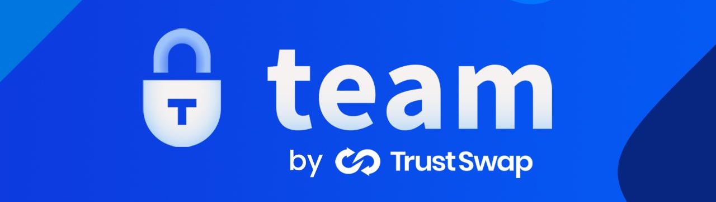
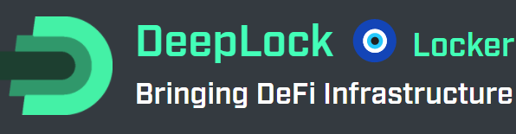
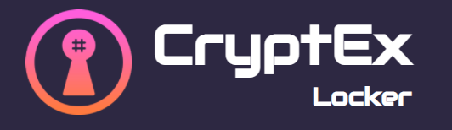
Competitors
>$ 10 bi
 | Value Locked
 | $ 6 B
 | $ 4,3 B
 | $ 53 M
market value
Source: Projects Interfaces @ 12/04/22

Slide 8
I L O C K S
competitive advantages
What makes I L O C K S superior to competitors

Slide 9

Competitors lack customization.
HOW MANY DAYS?
LOCK
CONFIG
VEST
USER
OPERATOR
HOW FREQUENTLY?

Slide 10
Let’s create an ILOCK!
I L O C K S dapp

Slide 11


the product is simple.
but powerful.
You can find me at: rafael-albuquerque-bezerra
albuquerque-rafael
I L O C K S dapp

